Slide 1
Shared Parking Tool User Guide
Python and GIS User Guide
July 2023

Slide 2

RSG ITE and ULI Spatial Parking Demand Tool
Table of Contents
SECTION 2: Installation & Running | 3-6
SECTION 3: Outputs & Post-Processing | 7-14
SECTION 4: Post-Processing Outputs | 15-16

Slide 3
SECTION 1:
INPUTS TO THE GIS PARKING TOOL

Slide 4
SECTION 2:
INSTALLATION & BACKGROUND SOFTWARE

Slide 5
BACKGROUND SOFTWARE
Necessary software to run the tool:
Conda via Anaconda or Miniconda
R and R Studio (https://posit.co/download/rstudio-desktop/)
GIS software (QGIS, ArcGIS, ArcMap)
Download the SPA Code:
Move/install “Shared_Parking” folder in root C drive or local Documents location
[INSERT SCREENSHOT FROM GITHUB]

Slide 6
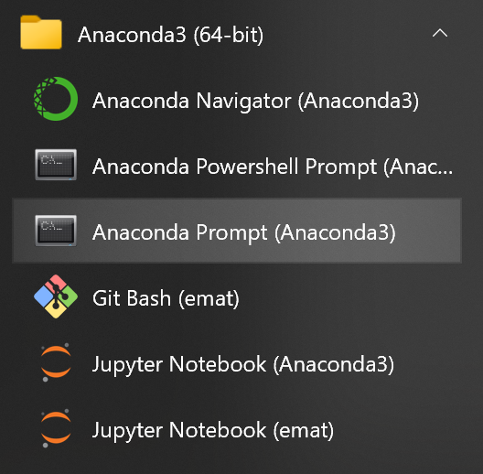
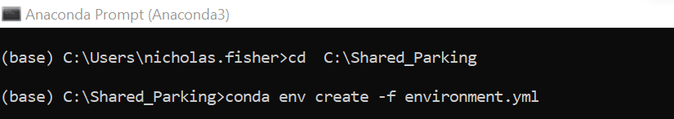
INSTALLING THE TOOL
Use Anaconda prompt to install the SPA Tool:
Open an Anaconda Prompt:
Install the Shared Parking Environment by running the .yml file:

Slide 7
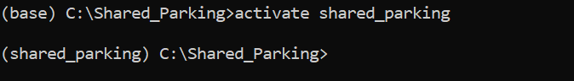
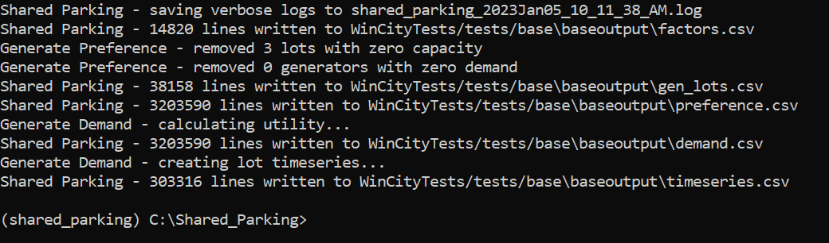
RUNNING THE TOOL
Use the Anaconda prompt to activate the SPA Tool:
Activate the SPA Tool
Run the tool using “cnfg.yaml” example configuration:
The following output should be produced:

Slide 8
SECTION 3:
OUTPUTS & POST-PROCESSING

Slide 9
OUTPUT DATA
CSV outputs for post-processing:
‘demand.csv’ : Demand for individual lots
‘factors.csv’ : Hourly adjustment factors for individual lots
‘gen_lots.csv’ : Parking generators with generator and lot IDs
‘preference.csv’ : Information for parking preferences
‘timeseries.csv’ : A time series of utilization by lot

Slide 10
R Studio
Screen shot of R Studio
Open R Studio to use the R software language to analyze the parking model results

Slide 11
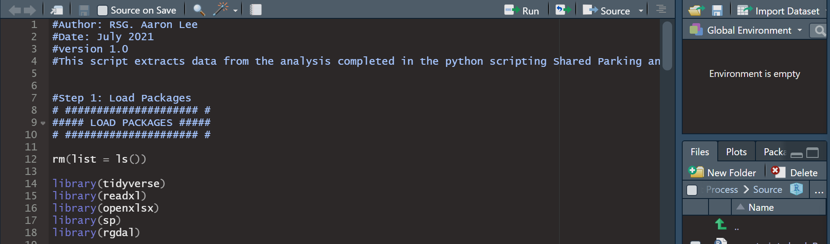
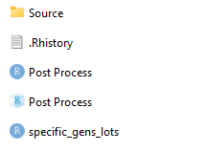
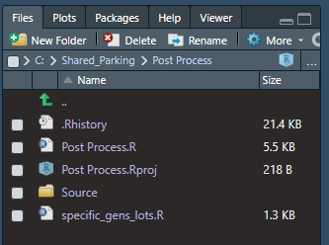
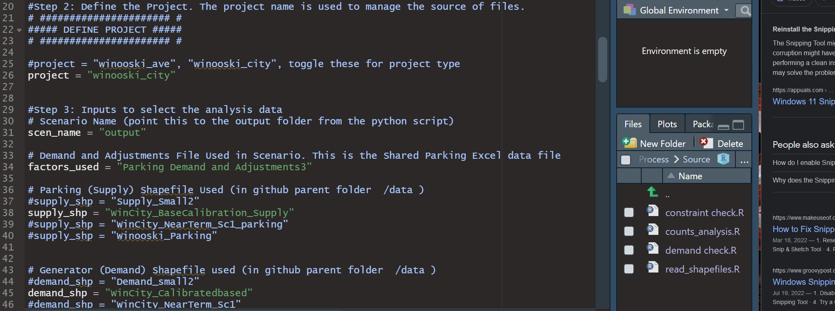
POST-PROCESSING
Open ‘Post-Processing’ folder:
Open R project titled ‘Post Process’:
In R Studio, open the ‘Post Process.R’ script:
Install and load required R packages:
Define the project type:

Slide 12
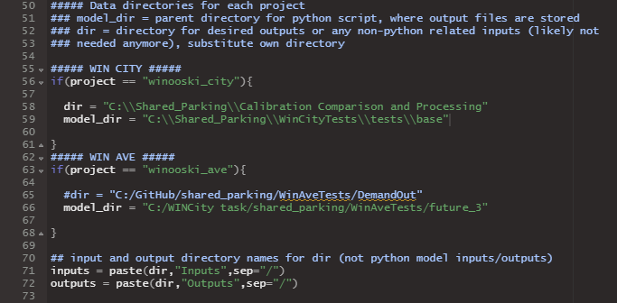
POST-PROCESSING
Set the directories:
The model directory should contain the folder titled “output.” In this example, we are using the project “winooski_city.” :

Slide 13
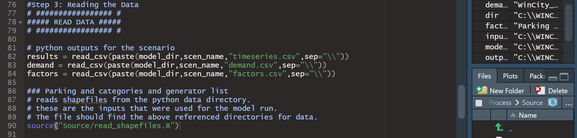
POST-PROCESSING
Read the data:
Read in outputs from the Python model and shapefile inputs used for the SPA model. The folder “Source” containing additional R scripts must be in the same directory as the R project to run these steps:

Slide 14
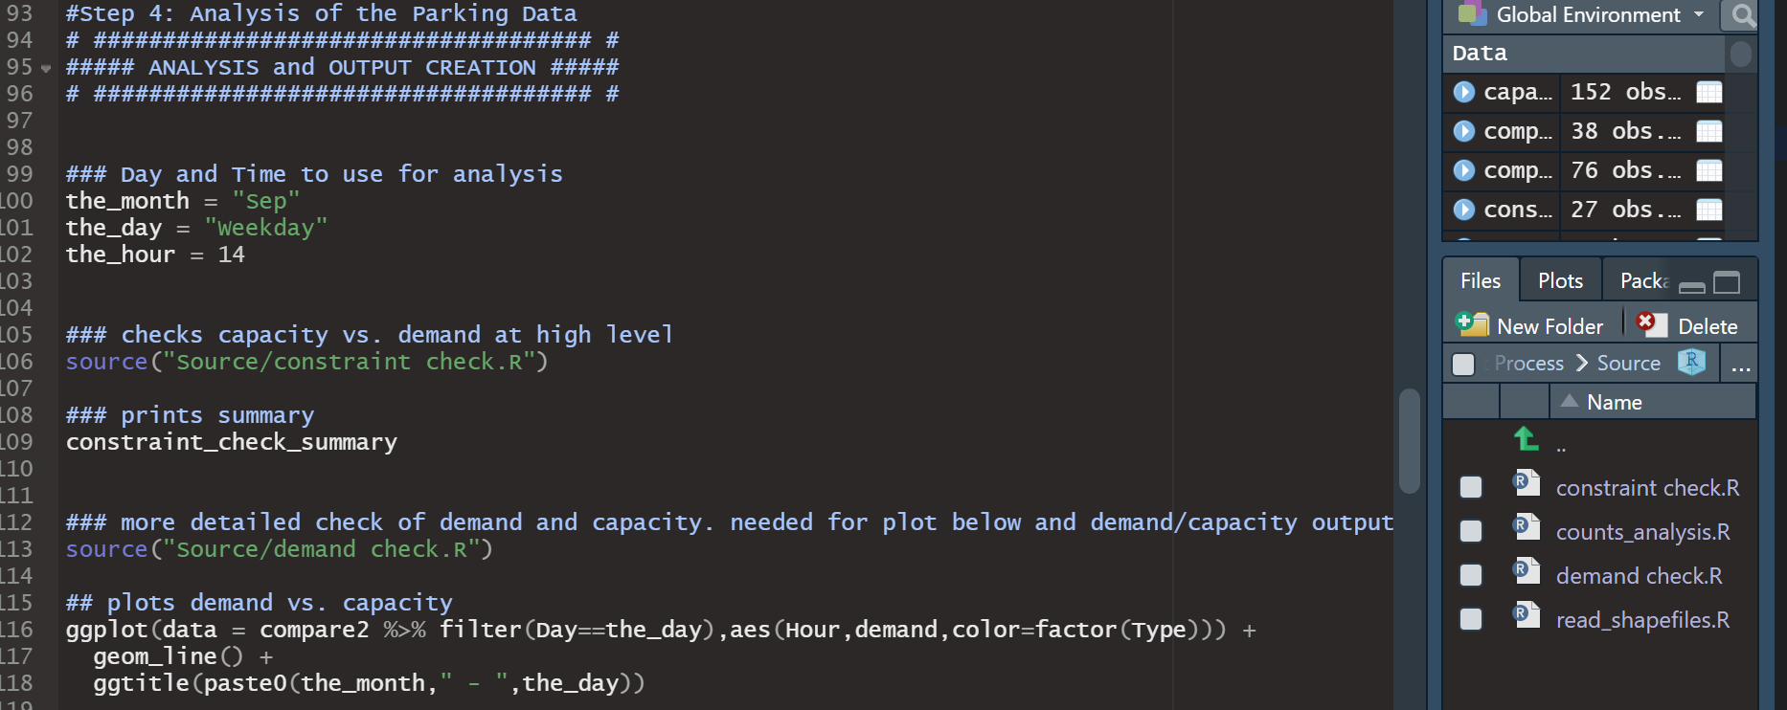
POST-PROCESSING
Analyze the parking data:
Run the constraint check and demand check scripts to project parking capacity versus parking demand:

Slide 15
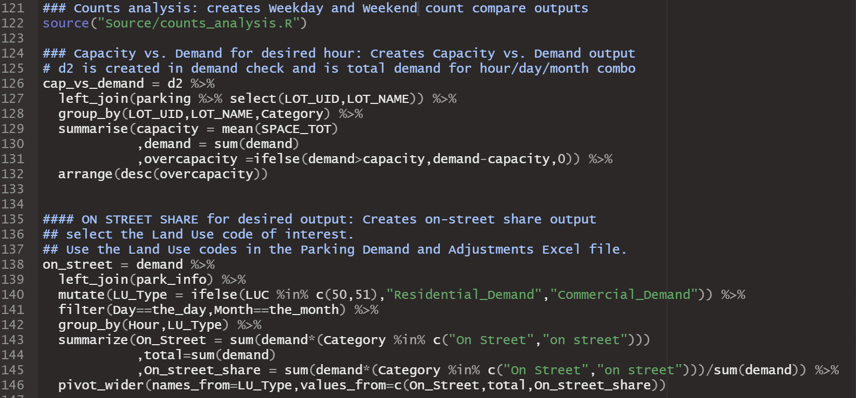
POST-PROCESSING
Perform counts analysis:
Develops counts for weekday and weekend demand by hour, day, and month:

Slide 16
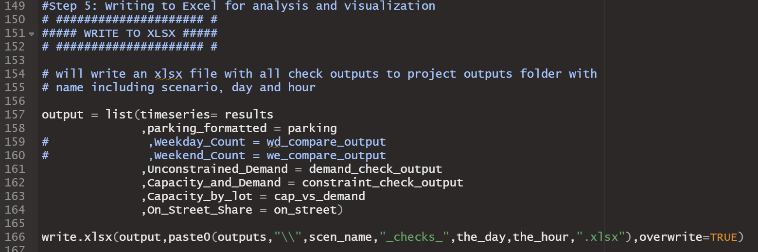
POST-PROCESSING
Export output:
Final step will export output as an Excel file:

Slide 17
SECTION 3:
POST-PROCESSING OUTPUTS

Slide 18
POST-PROCESSING OUTPUT
Post-processing will generate the Excel file ‘visualization.xlsx’ in the model directory:
“Overall summaries” : Contains pivot tables showing high-level summaries of parking by type or street with changeable filters for month, day, hour, and parking type (ex. Residential, on-street, commercial).
“OnStreet 3 period” : Shows on-street percent utilization for parking lots by street name for hours 8, 13, and 18.
“Single Street Pivot” : Shows total parking demand and percent utilization for all lots over a 1-day period on a given street.
“parking_formatted” : Geographic information of parking lots.
“timeseries” : Raw data for parking utilization by street, time, and land use.

Slide 19

Thank you
NOTE
PROJECT MANAGER NAME A
DIRECTOR
aproject.manager@rsginc.com +1 802 555 55555

